Slide 1
Discrete Structure Introduction
Week 1
By
Dr. Rafiullah Khan

Slide 2
Topics
What is Discrete Structure?
Logic
Propositional Logic
Logical Connectives

Slide 3
Introduction to Discrete Structures
Definition: Discrete structures refer to mathematical structures that are fundamentally discrete rather than continuous. They include sets, graphs, logic, functions, relations, etc.
Importance in Computer Science: Discrete structures are essential for understanding algorithms, data structures, computation, cryptography, databases, and more.
Applications:
Computer science
Cryptography
Algorithm design
Networking

Slide 4
Problems solved using Discrete Mathematics
How many ways are there to choose a valid password on a computer system?
What is the probability of winning a lottery?
Is there a link between two computers in a network?
How can I identify spam e-mail messages?
How can I encrypt a message so that no unintended recipient can read it?
How many valid Internet addresses are there?

Slide 5
Problems solved using Discrete Mathematics
What is the shortest path between two cities using a transportation system?
How can a list of integers be sorted so that the integers are in increasing order?
How many steps are required to do such a sorting?
How can it be proved that a sorting algorithm correctly sorts a list?
How can a circuit that adds two integers be designed?

Slide 6
Key Concepts in Discrete Structures
Sets: A collection of distinct objects.
Functions: A relationship between two sets, associating each element of the first set to exactly one element of the second set.
Relations: A set of ordered pairs defining how elements in one set are related to another set.
Graphs: A collection of vertices and edges connecting pairs of vertices, used to represent relationships between objects.
Combinatorics: Study of counting, arrangement, and combination of objects.

Slide 7
Mathematical Reasoning
Mathematical reasoning is the process of deriving conclusions from axioms or previously established results using logical steps.
Types of Reasoning:
Inductive Reasoning: Making generalizations based on specific observations (e.g., observing a pattern and hypothesizing it will continue).
Deductive Reasoning: Deriving specific results based on general principles or axioms (e.g., using theorems to prove a statement).
Abductive Reasoning: Inferring the best explanation for the observed facts.

Slide 8
Inductive Reasoning
Example 1:
Observation: Every time I’ve seen a black cat, it has been in a house.
Generalization: Therefore, I hypothesize that all black cats live in houses.
Example 2:
Observation: The sun has risen in the east every day of my life.
Generalization: Therefore, I infer that the sun always rises in the east.
Example 3:
Observation: Every time I’ve had pizza at this restaurant, it’s been delicious.
Generalization: Therefore, I conclude that all pizzas from this restaurant are delicious.

Slide 9
Deductive Reasoning
Example 1:
General Principle: All humans are mortal. (Premise 1)
Specific Case: Socrates is a human. (Premise 2)
Conclusion: Therefore, Socrates is mortal.
Example 2:
General Principle: If it rains, the ground gets wet. (Premise 1)
Specific Case: It is raining. (Premise 2)
Conclusion: Therefore, the ground will be wet.
Example 3:
General Principle: All squares are rectangles. (Premise 1)
Specific Case: This shape is a square. (Premise 2)
Conclusion: Therefore, this shape is a rectangle.

Slide 10
Abductive Reasoning
Example 1:
Observed Fact: The ground is wet.
Possible Explanations:
It rained.
Someone watered the plants.
Best Explanation: Given that it’s been cloudy all day, I conclude that it rained, even though I didn't directly see it happen.
Example 2:
Observed Fact: A person is coughing and sneezing.
Possible Explanations:
They have a cold.
They have allergies.
Best Explanation: Based on the time of year (spring) and the fact they also have itchy eyes, I infer they likely have allergies.
Example 3:
Observed Fact: A light is on in the kitchen.
Possible Explanations:
Someone left it on.
The light is malfunctioning.
Best Explanation: Since no one is in the kitchen, I infer that someone likely left the light on when they last used it.

Slide 11
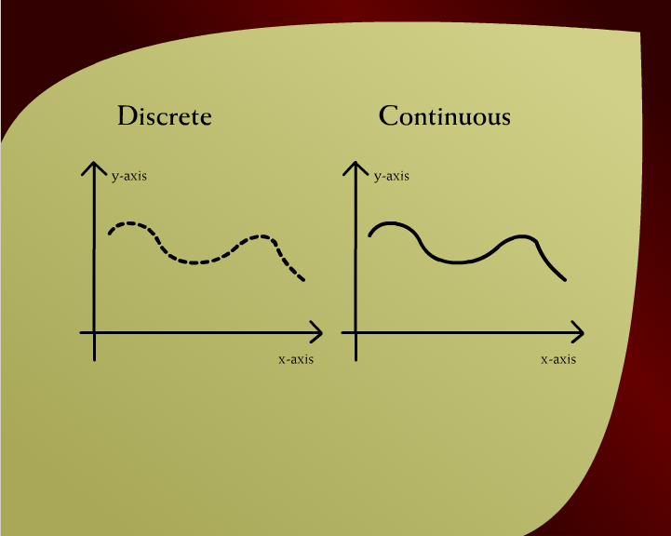
Discrete Continuous – 5a

Slide 12
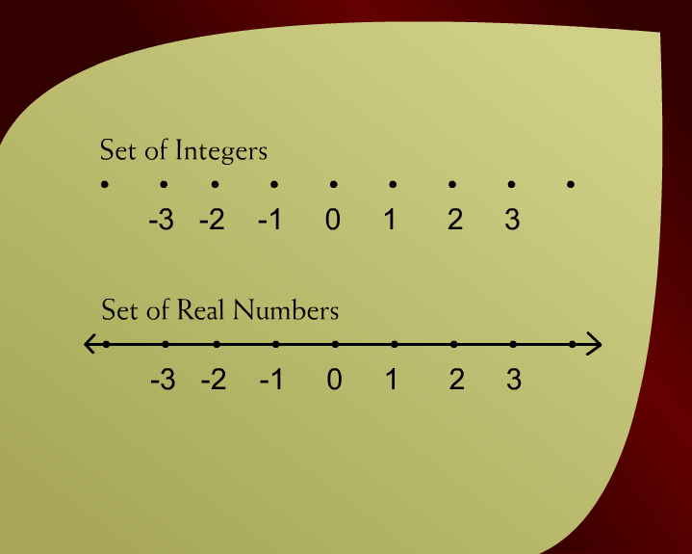
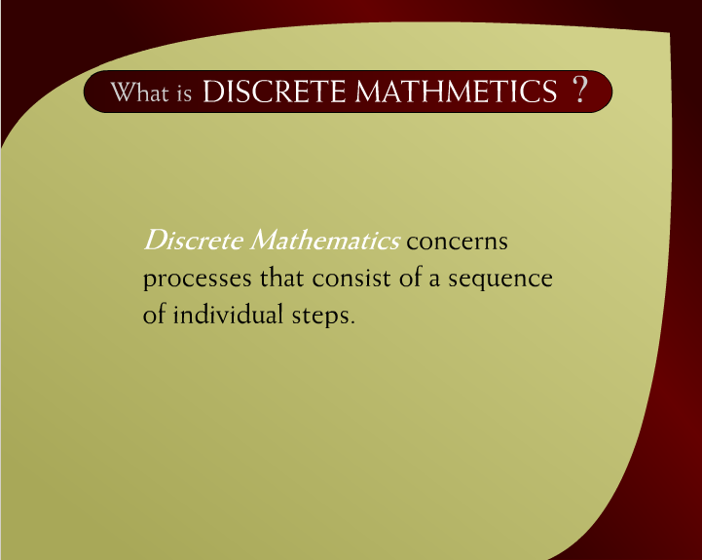
What is Discrete Mathematics – 6
Set of Integers & Real Numbers – 5b

Slide 13
What is Discrete Mathematics – 6

Slide 14
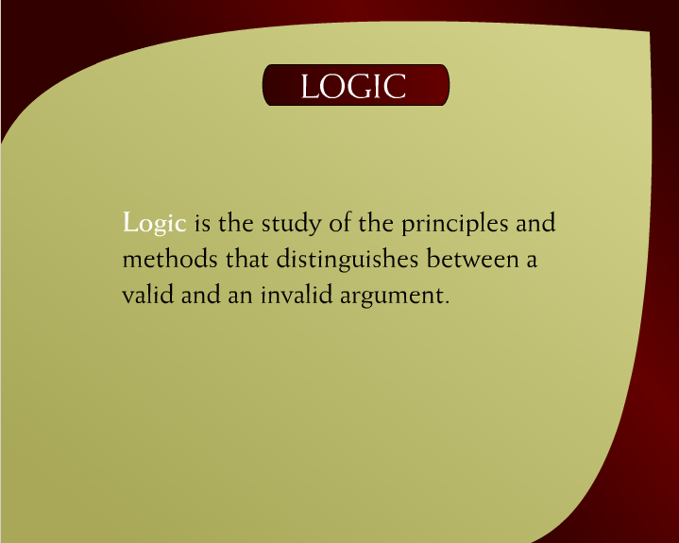
Logic – 7

Slide 15
Logic
Definition: Logic is the study of reasoning, specifically the principles of valid inference and correct reasoning.
Branches of Logic:
Propositional Logic
Predicate Logic
Importance in Computer Science:
Forms the foundation of algorithms, databases, programming languages, artificial intelligence, and verification systems.

Slide 16
Propositional Logic (Propositional Calculus)
Definition: Propositional logic deals with statements (propositions) that are either true or false, and the logical operations that can be applied to them.
Basic Components:
Propositions: Statements that are either true or false.
Logical Connectives: Operations that combine propositions.

Slide 17
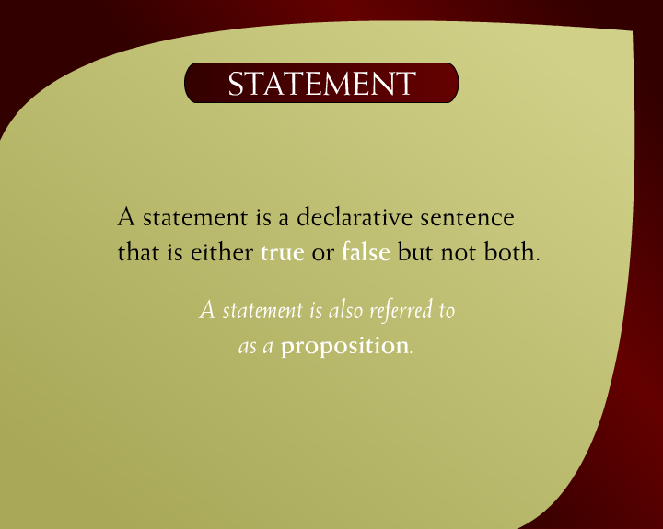
Statement – 8a

Slide 18
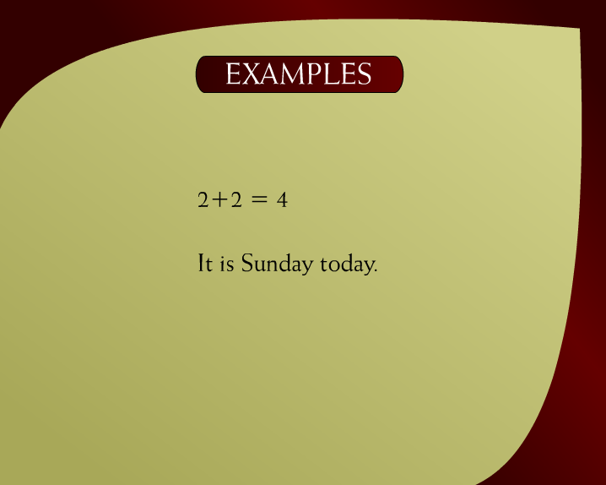
Examples – 8b

Slide 19
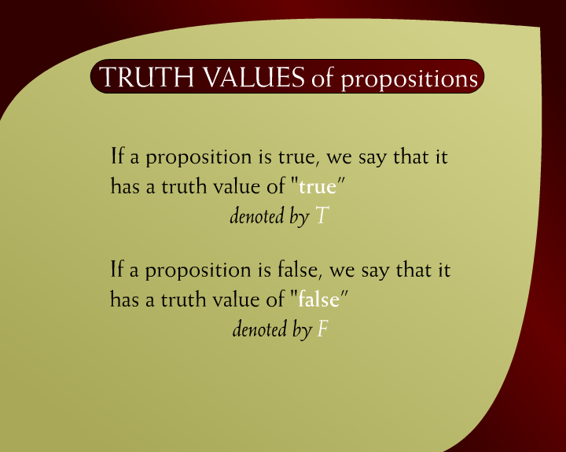
Truth Values of Propositions – 8c

Slide 20

Examples – 9a

Slide 21
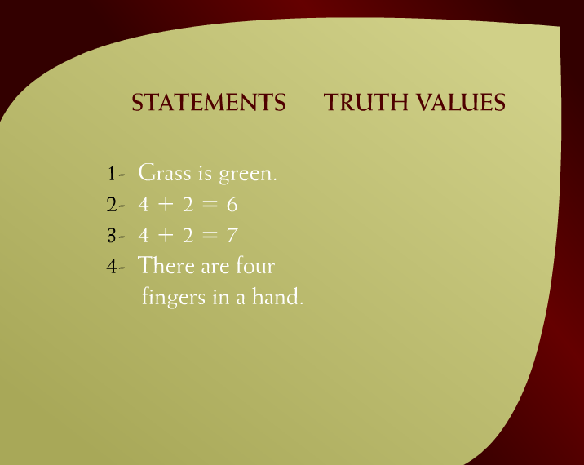
Statements & Truth Values – 9b
T
T
F
F

Slide 22
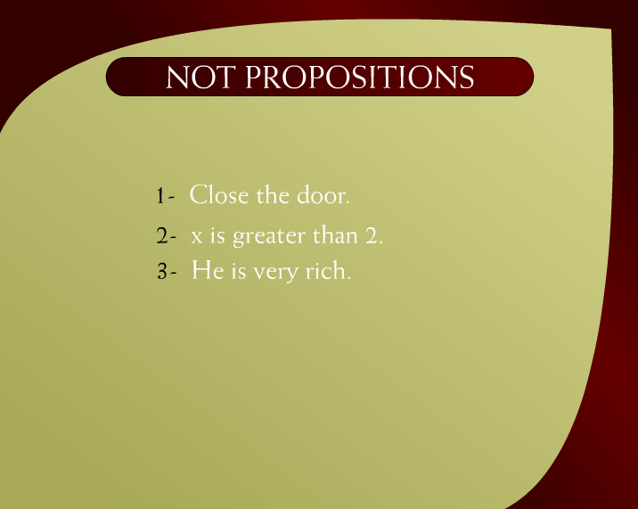
Not Propositions – 9c

Slide 23
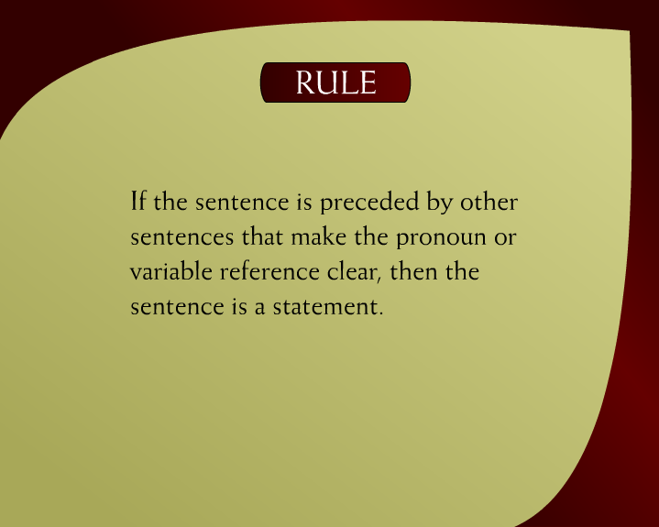
Rule – 10a

Slide 24
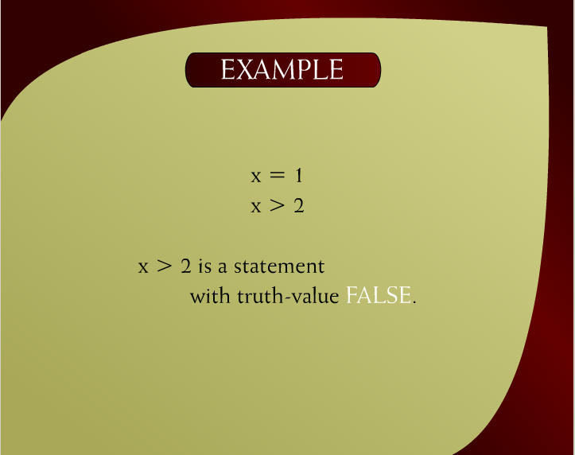
Example – 10b

Slide 25
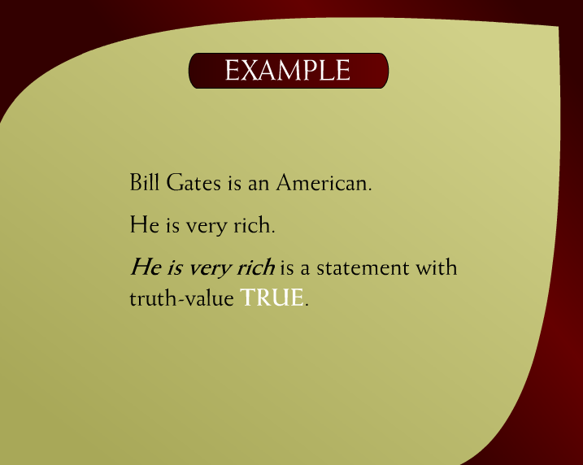
Example – 10c

Slide 26
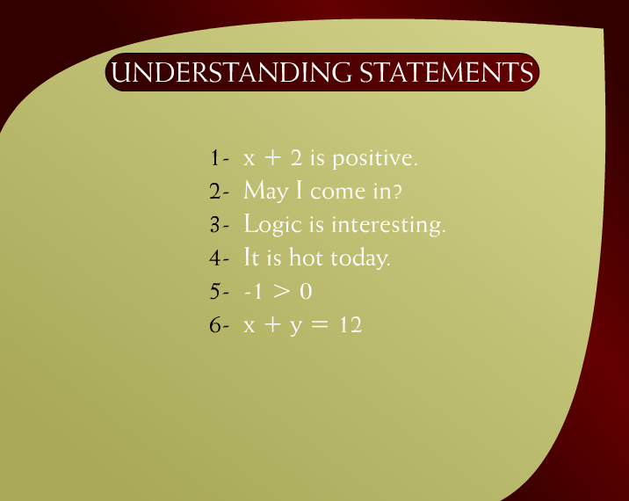
Understanding Statements – 11c

Slide 27
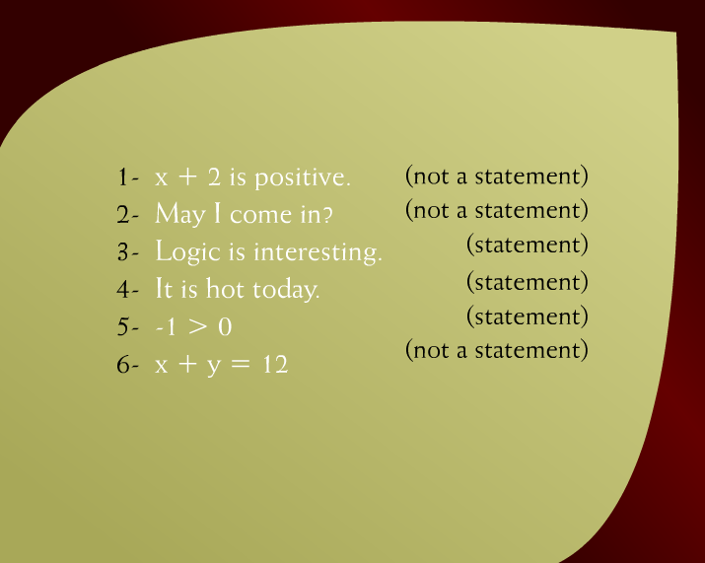
Example – 11b

Slide 28
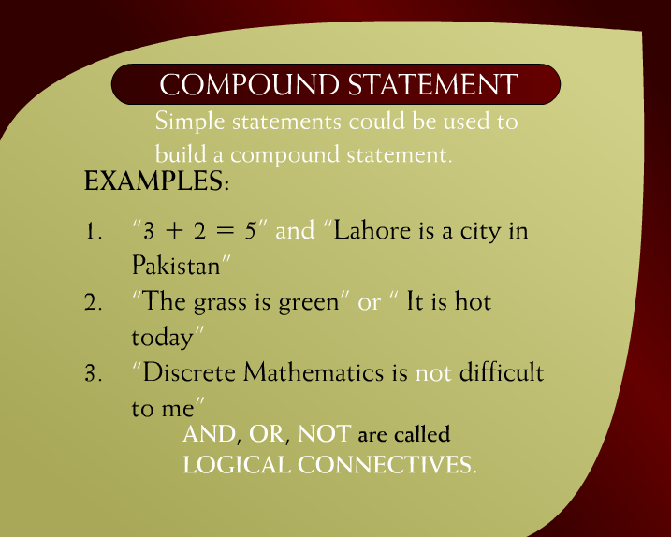
Compound Statement – 12a

Slide 29
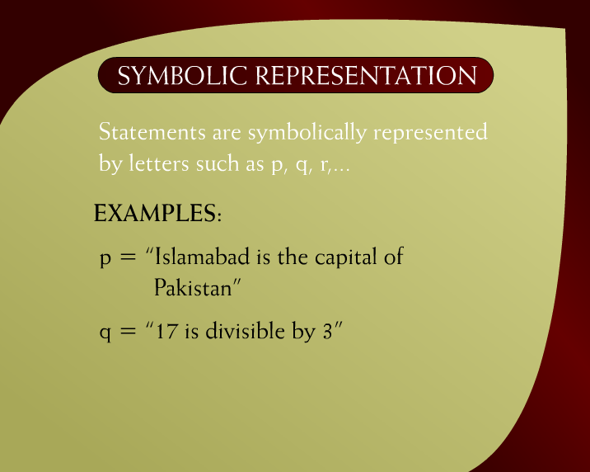
Symbolic Representation – 13a

Slide 30
Key Logical Connectives in Propositional Logic
NOT ( ¬ ): Inverts the truth value of a proposition.
Example: ¬P means if P is true, then ¬P is false, and vice versa.
AND ( ∧ ): Both propositions must be true.
Example: P ∧ Q means both P and Q must be true.
OR ( ∨ ): At least one proposition must be true.
Example: P ∨ Q means either P, Q, or both are true.
IMPLIES ( → ): If the first proposition is true, then the second must also be true.
Example: P → Q means if P is true, Q must also be true.
IF AND ONLY IF ( ↔ ): Both propositions must either be true or false.
Example: P ↔ Q means P and Q are either both true or both false.

Slide 31
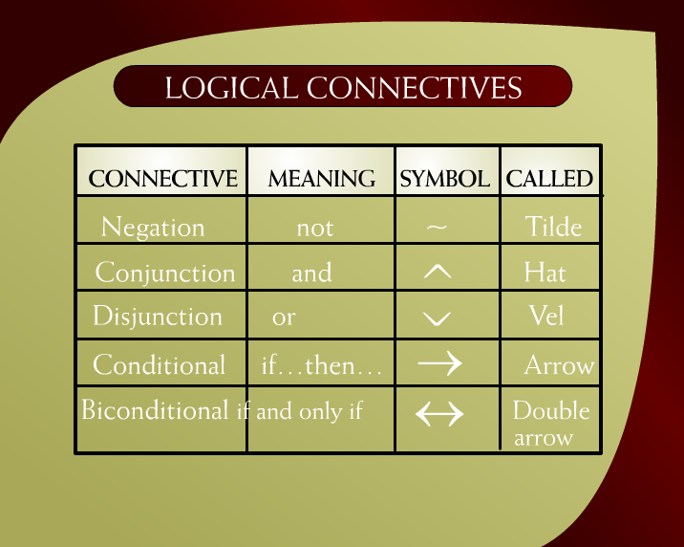
Logical Connectives – 14a

Slide 32
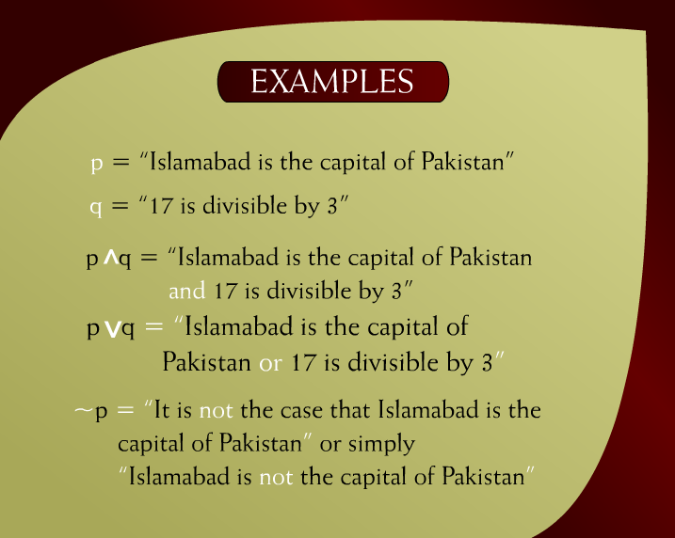
Examples – 14b

Slide 33
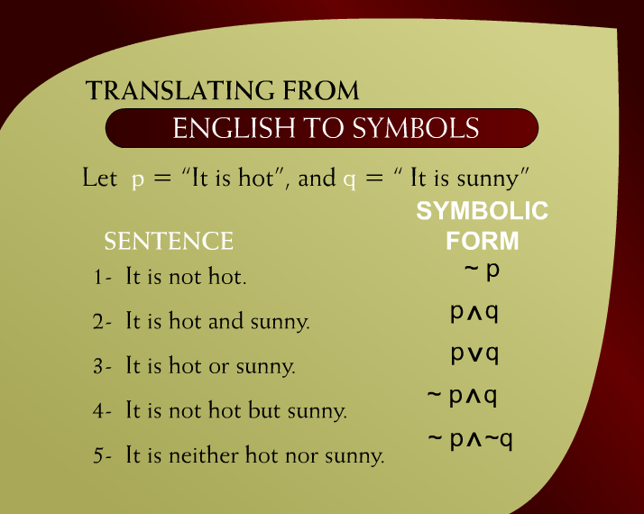
Translating from English to Symbols – 15

Slide 34
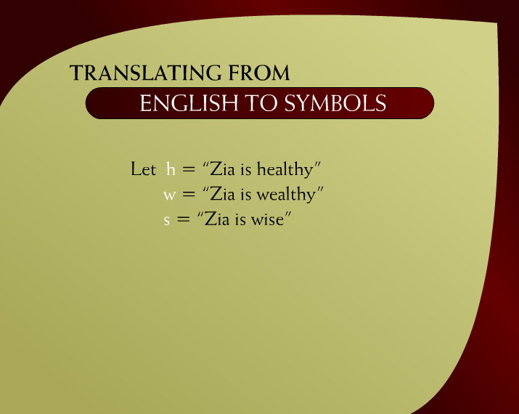
Translating from English to Symbols – 16a

Slide 35
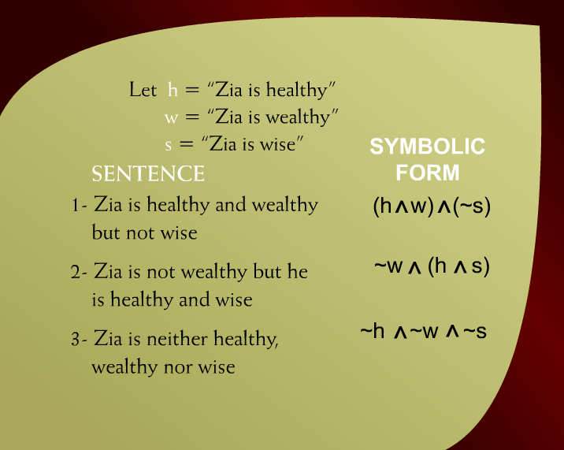
Translating from English to Symbols – 16

Slide 36
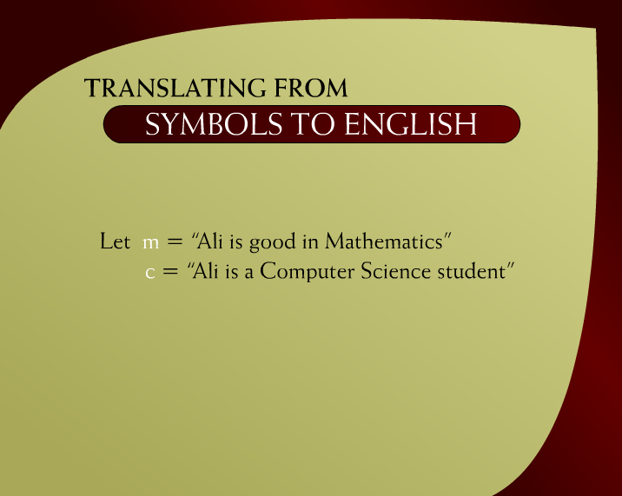
Translating from English to Symbols – 17a

Slide 37
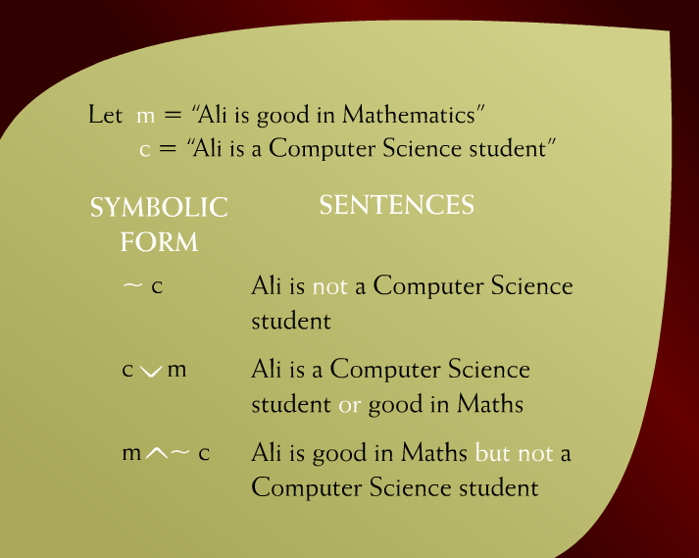
Translating from English to Symbols – 17b

Slide 38

Negation – 19

Slide 39
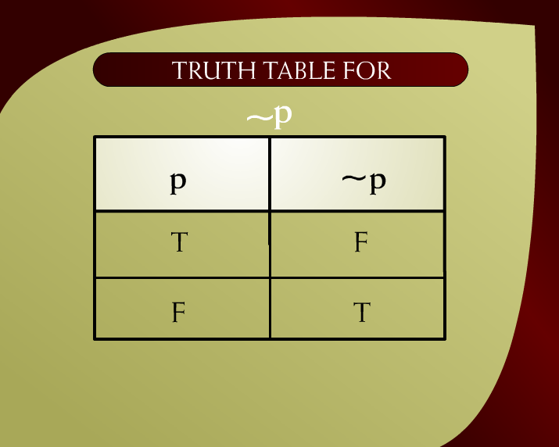
Truth Table for ~p – 20

Slide 40
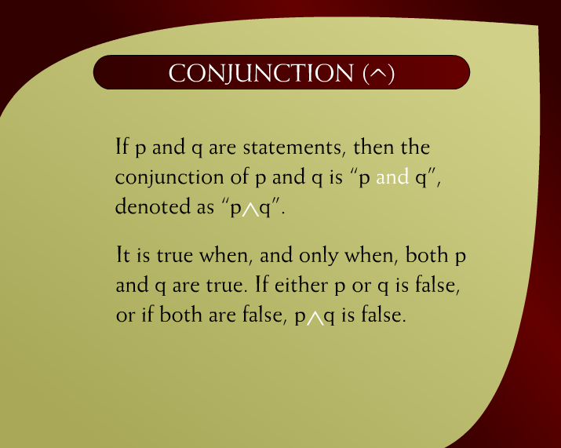
Conjunction – 21

Slide 41
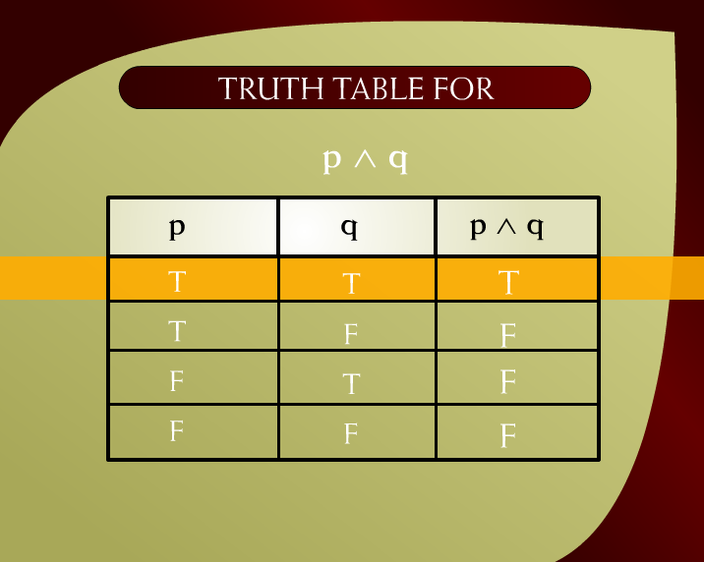
Truth Table for p ^ q – 22

Slide 42

Disjunction – 23

Slide 43
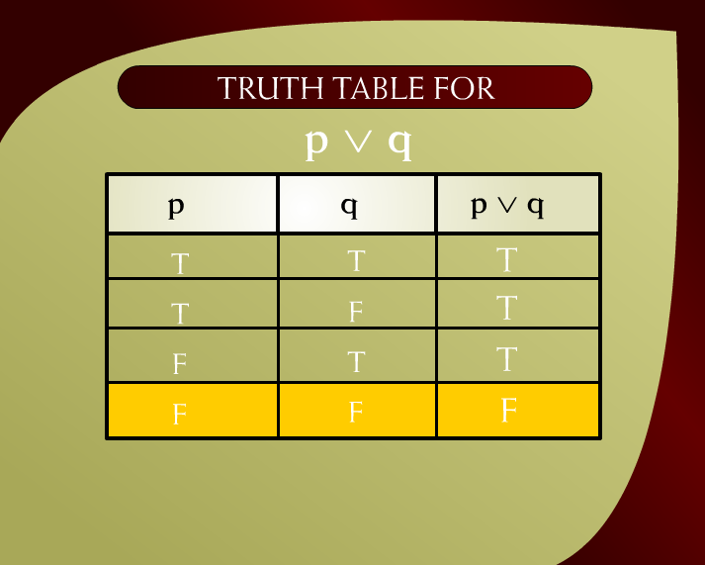
Truth Table for p q – 15

